Slide 1
Quantitative Phase Microscopy and Stimulated Raman Spectroscopy to Measure Cell Growth
Brian Wong, Robert Espinoza, & Thomas Ro
06/01/21

Slide 2
Outline
Background
Methods
Results
References, Acknowledgements, & Questions

Slide 3
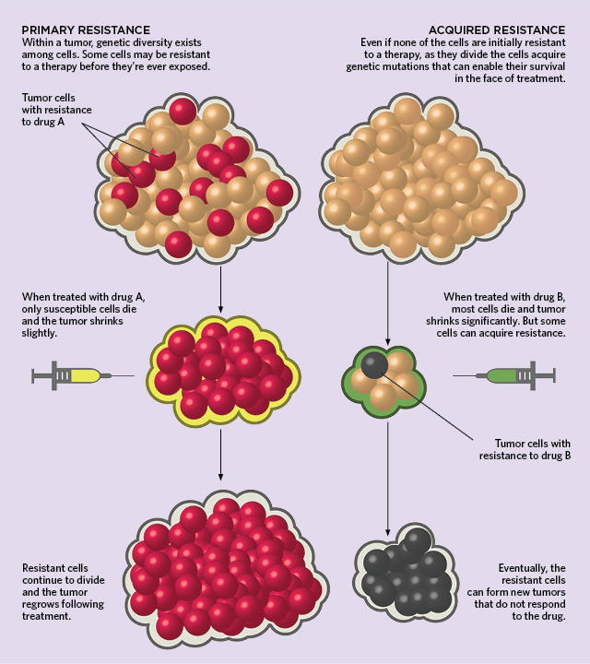
What Problem Are We Trying to Tackle?
Cancer: drug resistance , heterogeneous 3D microenvironments, and drug intake
Probing single cell exposure & response
Single cell growth as an indicator of drug exposure and response
Current methods:
Micro Electro-Mechanical System Sensors (MEMS)
Quantitative Phase Microscopy (QPM)
Stimulated Raman Spectroscopy (SRS, hopefully!)
How Cancers Evolve Drug Resistance | The Scientist Magazine
Notes:
So, what problems are we trying to tackle?
-Cancer cells grow resistance to drugs over the course of the drug therapy.
If you look at the diagram on the right side, on the left, it shows tumor cells with few that already have resistance to drugs. This is due to simply a genetic diversity among cells. When you treat these cells with a drug, only the non-resistant ones will die and the surviving cells will grow and divide into tumor again.
Similarly, on the right side of the figure, no cells have resistance. When treated with a drug, most of the cells in the tumor will die but some will acquire resistance, and they will form new tumors that do not respond to the drug.
- However, there are very little understanding of how these cells acquire resistance to drugs.
-The heterogeneous environment and the type of drug used for therapy all affect how the cells gain resistance.
-To achieve a better understanding of how cells grow and acquire drug resistance, we decided it is necessary to probe single cell growth as an indicator of drug exposure and response.
There are three promising methods to detect cell growth: MEMS, QPM, and hopefully, SRS.
What we did in this project was to build a way to segment, detect, and track cells in microscope images collected from QPM.

Slide 4
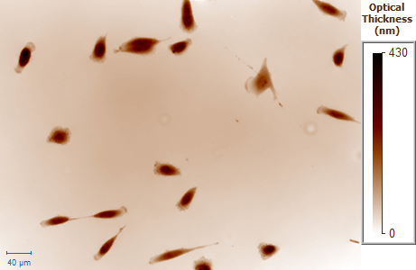
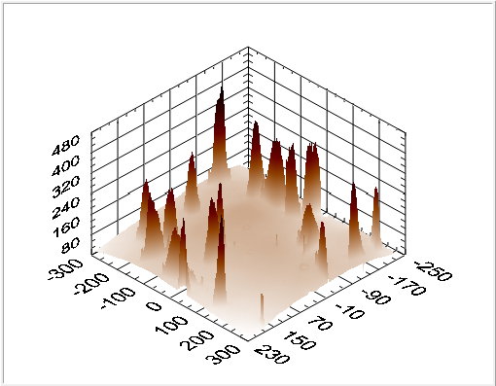
Background: Quantitative Phase Microscopy (QPM)
Branch of methods that quantify the phase shift
Intensity of pixel corresponds to the optical thickness
Lipid droplets == dense == dark
Vacuoles == less dense == bright
Limited to cell monolayer cultures
Notes:
the meat, backbone or golden standard of cell growth detection is Quantitative Phase microscopy or QPM, QPM refers to a branch of methods that are able to quantify the phase shift that occurs when light passes through a more optically dense object
here is a QPM image, as I implied, the intensity of a pixel has a direct physical meaning, the optical thickness of a cell is the physical height of the cell multiplied by the optical density of the cell at that point. If we were looking at more resolved cell structures like lipid droplets which are dense and therefore in this color scheme would appear dark while vacuoles which are less dense would appear more bright
one drawback of QPM is that it is limited to cell monolayer structures

Slide 5
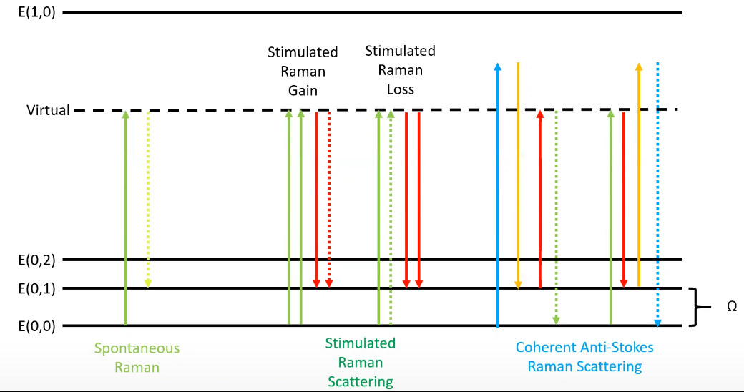
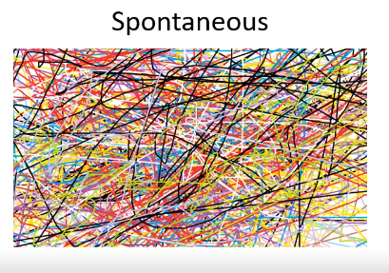
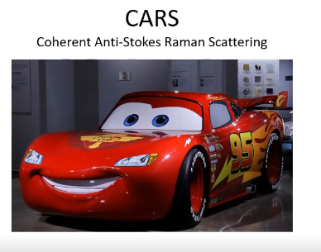
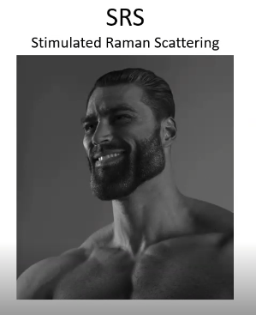
Background: Stimulated Raman Spectroscopy (SRS)
Vibrational techniques to virtually excited states
Low probability
Spontaneous Raman ~1 in 10⁸
Stimulated Raman
Orders of magnitude higher
Notes:
we hope to supplement QPM images with a type of vibrational spectroscopy
In our specific vibrational spectroscopy field there is three techniques I want to cover in this crash course of a slide
These techniques make use of Infrared photons to cause vibrational transitions to virtually excited states, this is a very low probability process
in spontaneous raman youre basically rolling the dice over and over and observing transitions with odds of about getting 1 hit every 10^8 photons.
in stimulated raman youre assiting or driving the raman process by the fundamental of stimulated emission
In SRG you have two high energy photons of pump photons while having one stokes or lower energy photon, ultimately emiting a new stokes or higher energy photon to be detected. in SRL it's the opposite
Lastly theres CARS or coherent antistokes raman, cars is a little bit more complex, it involves anti-stokes shifts or a gain of a vibrationally excited state
as you can see I have two different arrangements and more colors of photons flying around, what I havent shown are the other 48 pathways that CARS can follow to show signal, and frankly that doesn't belong
**start the transition** *In simple terms* SRS is your workhorse of vibrational biological imaging, free of nonresonant background and linearly proportional to concentration
There’s three techniques I want to discuss at some length I’ll try to make it brief but concise
Nonlinear involving more than one photon
They are third order nonlinear processes, meaning you have three photons interacting and then a fourth photon coming out and thats the photon that youre trying to detect, carrying information. In SRG you have two pump photons and one stokes photon and then the system will emit a new stokes photon so what you see here is a gain in your stokes beam. In STL you have two stokes photon interacting and one pump photon interacting, giving you an emitted pump proton to detect that will actually lead to a destructive interference in your pump beam and this youll be detecting a loss intensity of your pump beam
SRS has quadratic relationship with concentration whereas CARS isn’t simply quadratic bc theres also noise
CARS a little more complex, you can see I have two different arrangements and more colors of photons flying around, what I havent shown are the 48 other pathways that CARS can follow to show signal
In Spontaneous youre basically rolling the dice over and over and observing transitions
CARS takes rather a long time to experimentally set up & to change at what energy youre probing, also its not free of nonresonant noise
In SRS youre assisting or driving the raman process by the fundamental of stimulated emission

Slide 6
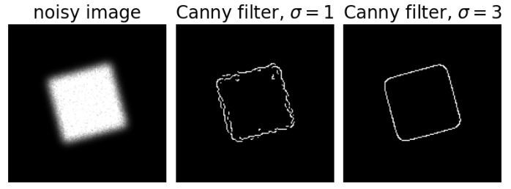
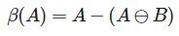

Methods: Binary Mask & Edge detection
Binary mask based on use of greater than operator
Edge Based Segmentation
Derivative of a Gaussian used to compute the intensity of the gradients
canny(img,sigma,low,high)
Hysteresis threshholding
Boundary Extraction
Binary image minus eroded binary image
Notes:
The Gaussian reduces the effect of noise present in the image. Then, potential edges are thinned down to 1-pixel curves by removing non-maximum pixels of the gradient magnitude. Finally, edge pixels are kept or removed using hysteresis thresholding on the gradient magnitude.

Slide 7
Methods: Object detection/Tracking with YOLOv5 + NORFAIR
a real-time object detection framework and stands for You Only Look Once. Image is only passed once through the FCNN, or fully convolutional neural network.
Easy to learn, very minimal background coding knowledge is required
Labeled 100 images based on binary mask & edge detection - batch 16 & 100 epochs
Used Azure VM to train the model - save time and resources
When completed, used the weight produced with YOLOv5 to track cells with Norfair (confidence threshold: 0.25, iou threshold: 0.45)
Github for YOLOv5 : https://github.com/tryolabs/norfair Github for Norfair: https://github.com/tryolabs/norfair
Notes:
From the segmented image, we built our ground-truth to train our detection model YOLOv5 and tracking model Norfair.
YOLOv5 is a real-time object detection framework and stands for You Only Look Once. Image is only passed once through the FCNN, or fully convolutional neural network. It is very easy to learn and require minimal background knowledge in coding, which was perfect for us.
Based on the segmentation, we labeled 100 images and trained them through YOLOv5 using Azure Virtual Machine which saved us time and resources.
Upon completion of the training, we used the generated weight to run our tracking model, Norfair, which is a customizable lightweight Python library for real-time 2D object tracking.

Slide 8
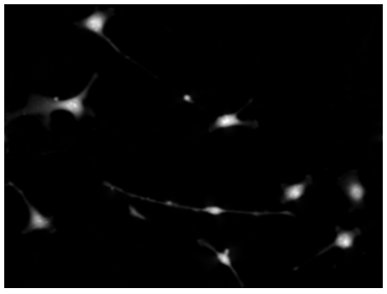
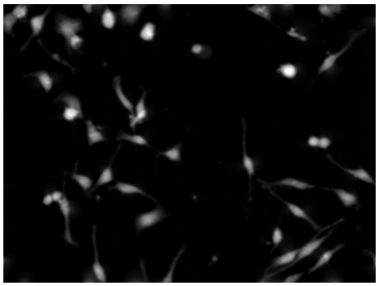
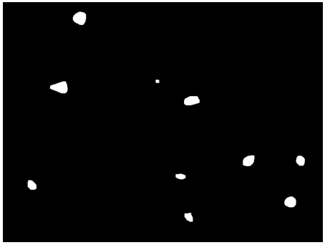
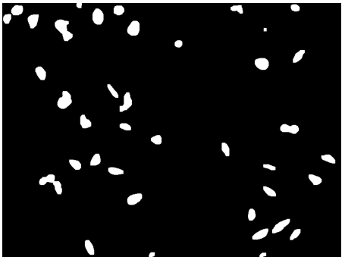
Results: Binary Mask
Rather simple but effective
285 images
HeLa cells take up rather irregular shapes and split very frequently
Basis for further segmentation

Slide 9
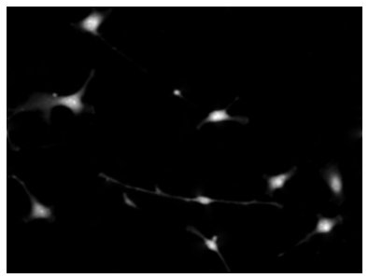
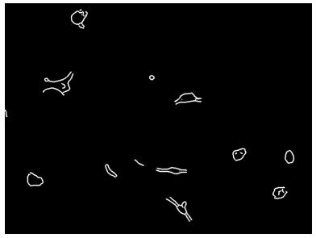
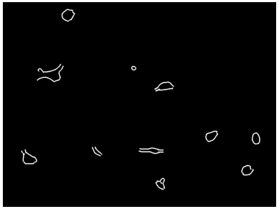
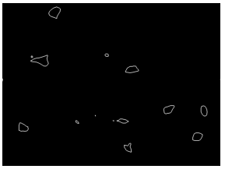
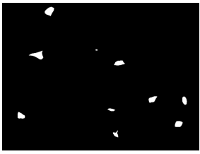
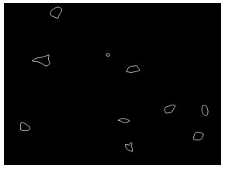
Results: Edge Based Segmentation & Boundary Extraction
Top row is canny edge detector
No good sigma value
Bottom row is boundary extraction with skimage connected components function
Need to apply this to whole data set

Slide 10
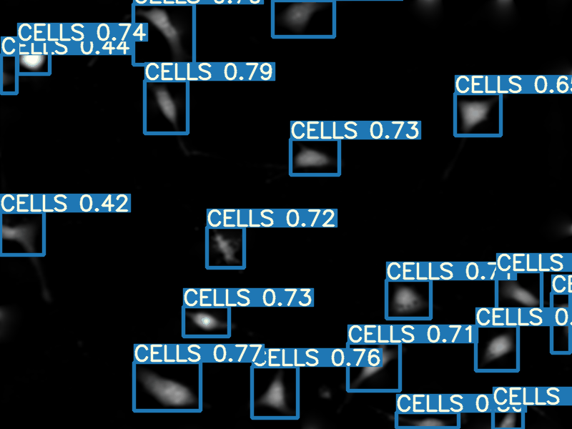
Results: Cell detection with YOLOv5
187 images
Cells are surrounded by boxes with confidence score shown
Detection occurred image by image (Frame by frame)

Slide 11
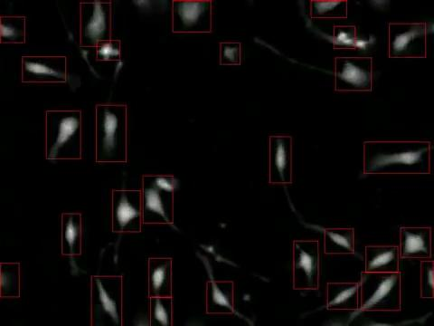
Results: Cell tracking with Norfair
Ran over entire images (including 100 images that were used to train YOLOv5)
Tracking was done through the video (vs image for detection)
Notes:
In object detection, we detect an object in a frame, put a bounding box or a mask around it and classify the object. Note that, the job of the detector ends here. It processes each frame independently and identifies numerous objects in that particular frame.
Now, an object tracker on the other hand needs to track a particular object across the entire video. The detector needs to track across the subsequent frames.
Still more ways to go - need to dive more deeply into the code and use its tracking to maximum.

Slide 12
Takeaways
Our group would like to supplement QPM images with stimulated Raman spectroscopy (SRS) microscopy images. SRS uses the intrinsic vibrational modes to not only generate identifiable spectra but also does not have any nonresonant background signal
Code we learned in class serves as a rather simple but powerful data processing tool
Simple, easy-to-learn models are wonderful, but to fully understand and take advantage of their potentials, must learn how they work.
Notes:
So not only did we briefly introduce QPM and SRS but ideally our group would like to [bullet point 1]

Slide 13
Questions?

Slide 14
Supplemental Information

Slide 15
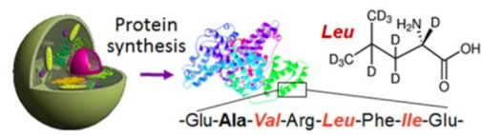

Experimental methods - Deuterium labeling
Deuterated leucine, isoleucine, and valine (d-LIV)
Cell growth stays the same in d-LIV supplemented culture medium
Cells incorporate carbon-deuterium (CD) bonds

Slide 16
Experimental methods overview
Cell growth
Protein
(~70% of cell dry mass)
Cell m₁
Protein amount₁
Time
Cell m₂
Protein amount₂
We use protein synthesis rate as a proxy measurement

